Slide 1
Work package 3

Slide 2
New tasks for HAMK?
Currently HAMK does mainly data/visualization and FO maintenance.
HAMK could get more involved in the scientific work.
Match HAMK capability to do research.
Would help HAMK undestand related project goals and help guide work towards those.

Slide 3
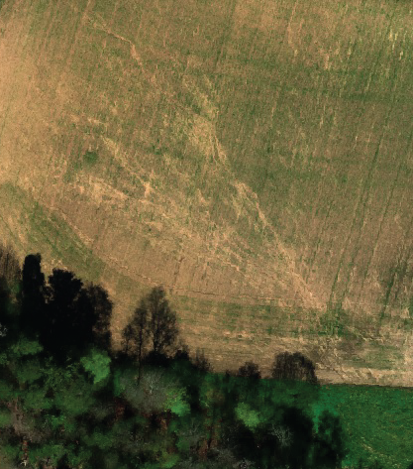
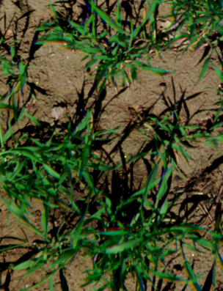
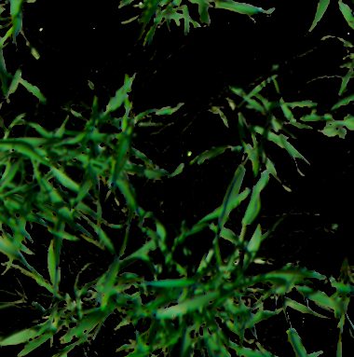
Task proposal 1: Conditional generative machine learning models for remote sensing data synthesis and analysis
Satellite image
(Generated) aerial images
(Generated) close-up images
Generated 3-d models
*
Super-resolution generator
3-d model generator
Image: ESA
(Illustration)
Calibrated
models
Direct calculation
*Preliminary work done
Extensions:
Time series data
Other inputs (weather etc.)
Other outputs (plant species etc.)
Vegetation variables
LAI

Slide 4
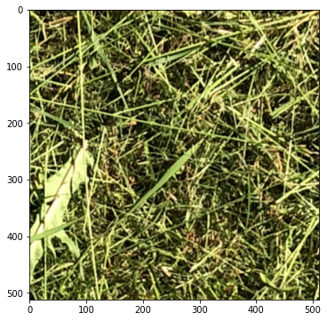
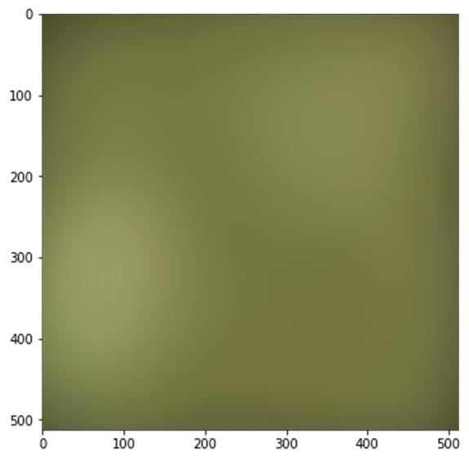
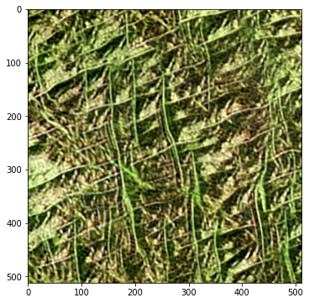
Preliminary results using a convolutional neural generative adversarial network
Task proposal 1: Conditional generative machine learning models for remote sensing data synthesis and analysis
Resolution
reduction
Super-resolution generator
Real data
Low-resolution copy (Illustration)
Fake data

Slide 5
Task proposal 1: Conditional generative machine learning models for remote sensing data synthesis and analysis
HAMK has own fields but no data collection planned at the moment.
Input data needed:
Drone imagery
HAMK has done preliminary work to plan a preprocessing pipeline (Task proposal 2)
Close-up imagery
Direct measurements (LAI, what else?)

Slide 6
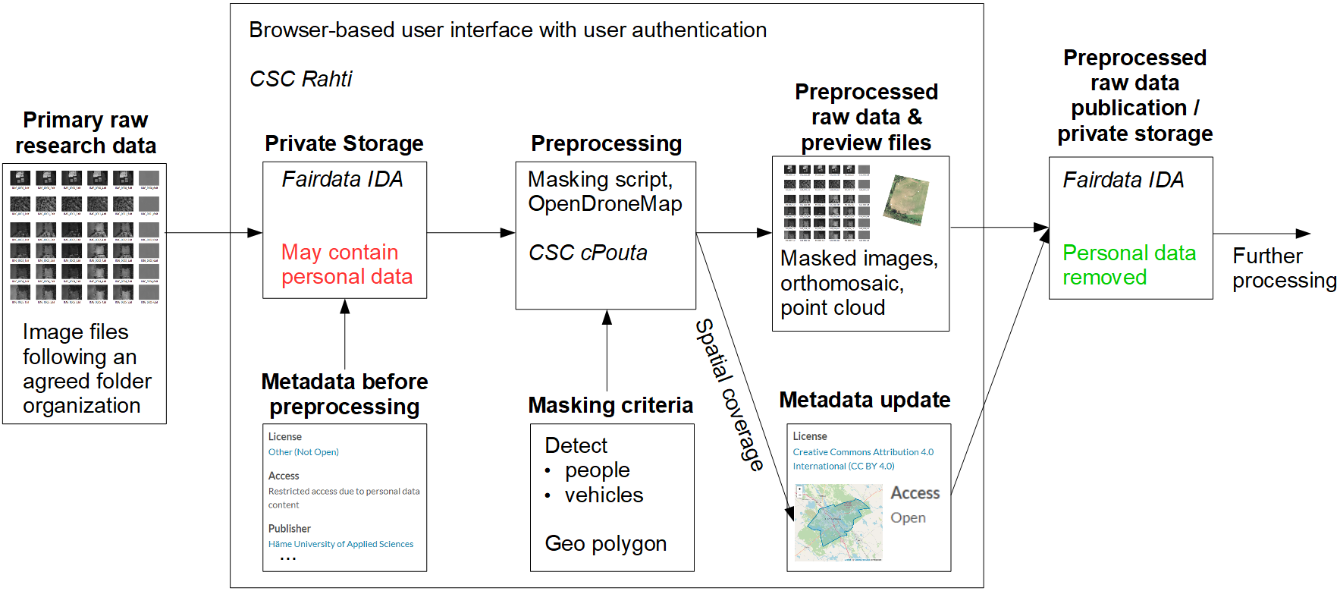
Task proposal 2: Drone data preprocessing pipeline

